Slide 1





BUILD WEB APPLICATION FROM SCRATCH by
FAKULTAS ILMU KOMPUTER
UNIVERSITAS SRIWIJAYA
UNSRI MENGAJAR 2021
Aditya Dharmawan Saputra
WEB DEVELOPER
@adityadees
BAB III : Instalation And Configuration Laravel
LARAVEL – BOOTSTRAP - MYSQL

Slide 2
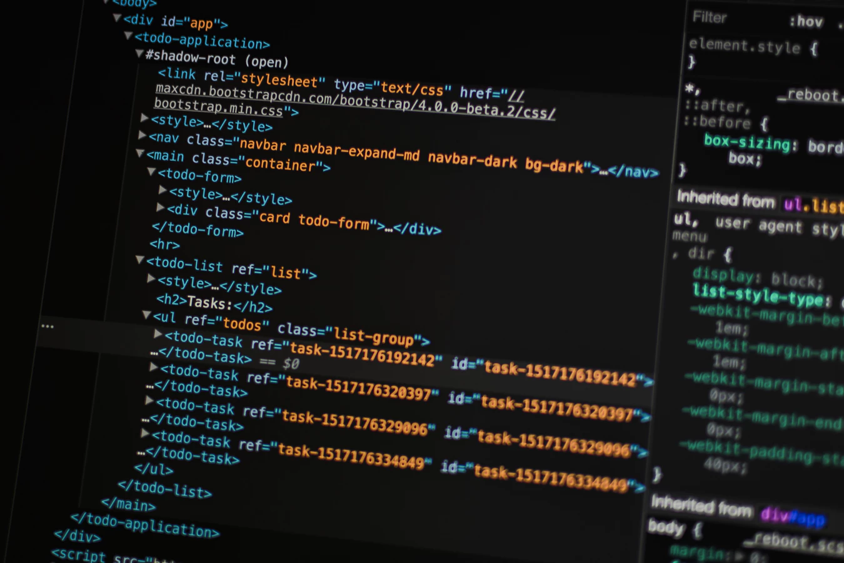
Instalation Laravel
Local
Global

Slide 3
Installation Laravel
Local

Slide 4
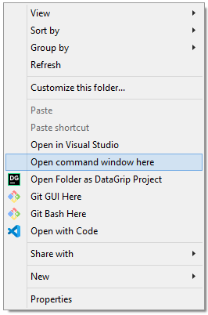
Local Installation (Windows OS)
1. Buka Terminal dengan cara :
shift+klik kanan mouse
2. Lalu pilih
Open Command Windows Here

Slide 5
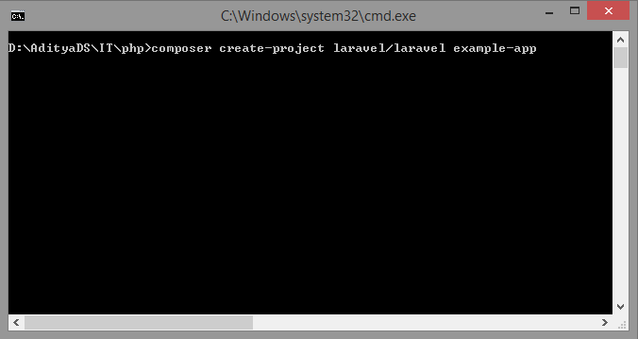
3. Kemudian ketikan perintah composer create-project laravel/laravel example-app lalu tekan enter

Slide 6
Thank You

